Slide 1
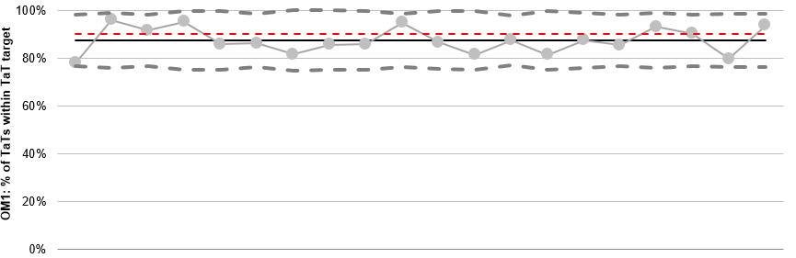
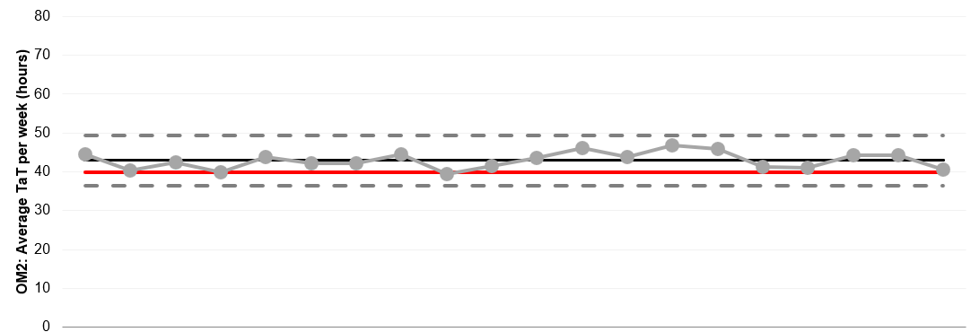
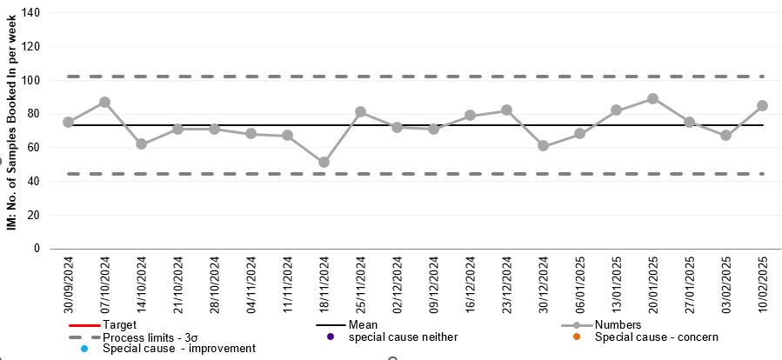
7 Apr 2025
Performance (Outcome Metrics) and Referrals (Input Metric)
No Special Cause flags (warnings of potentially non-random behaviour):
Referral volumes and TaT performance look stable

